Slide 1
Advanced JavaScript

Slide 2
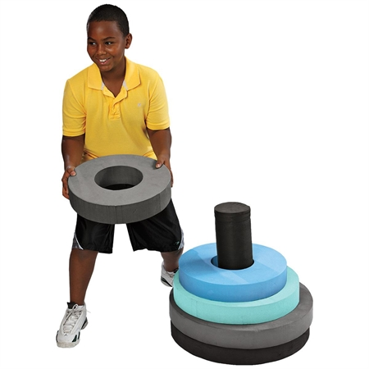
Tower of Hanoi

Slide 3
Coming Up
object
function
prototype
closure
Encapsulation
Inheritance

Slide 4
What is object
An object is a container of properties, where a property has a name and a value.
A property’s value can be another object

Slide 5
What is object
Simple types: numbers, strings, booleans, null and undefined.
All other values are objects.
(arrays, functions, objects)

Slide 6
Retrieval and update
Values can be retrieved by a [ ] suffix or the . notation
  people.name
  people[“name”]
When updated, if the property name exists, the value is replaced, or the property is added.

Slide 7
function
Function Invocation
Method Invocation
Constructor Invocation
Apply(call) Invocation

Slide 8
Function Invocation
“this” is bound to global object
    var add = function(a, b){
    return a + b;
    //what is this
    }
    add(3, 4);

Slide 9
Method Invocation
When a function is stored in an object, it’s called a method
When a method is invoked, “this” is bound to that object

Slide 10
Constructor Invocation
When functions are designed to be used with new, they are called constructors.
Something happens in constructor invocation:
    Create a new object
    Bound “this” to that object
    Execute the function
    Return that object

Slide 11
Apply Invocation
apply is a method of a function
apply lets us choose the value of “this”

Slide 12
prototype
When a function object is created, it is given a prototype member.
Prototype object
prototype

Slide 13
prototype
objects that are produced by calling the function with the new operator have a secret link to the prototype
constructor
Prototype object
prototype
Constructor
object

Slide 14
prototype
You can add other members to a function's prototype, they can be used by the “new objects”.
People
Prototype object
prototype
COUNT_OF_LEGS | 2
york
Name | “York”

Slide 15
Encapsulation
Factory Pattern
Constructor + Prototype Pattern
    Constructor Pattern
    Prototype Pattern
Durable Pattern

Slide 16
Factory Pattern
  what type of object the object is?

Slide 17
Constructor Pattern
  There is no object being created explicitly.
  The properties and methods are assigned directly onto this.
  There is no return statement.

Slide 18
Constructor Pattern
  Instances can be identified as a particular type later on.
  (the constructor property)
  It’s dangerous to call it without the new operator.
  Methods are created for each instance.

Slide 19
Prototype Pattern
People
Prototype object
prototype

Slide 20
Prototype Pattern
People
Prototype object
prototype
name: | “York”
age: | 1
sayName:

Slide 21
Prototype Pattern
People
Prototype object
prototype
name: | “York”
age: | 1
sayName:
york
sean
name | “Jasper“

Slide 22
Prototype Pattern
  Properties and methods are shared among object instances.
  All instances get the same property values by default.
  The modifications on the property containing a reference value are reflected on all object instances

Slide 23
Constructor + Prototype
Inheritance
  Each instance has its own copy of properties.
  All instances share references to methods.(conserve memory)
  Is the most widely used and accepted pattern

Slide 24
Closure
  JavaScript has function scope.
  Inner functions get access to parameters and variables of outer functions
  Closure helps to protect data.

Slide 25
Durable Pattern
  Don’t add public properties.
  Don’ reference the this object
  Create secret information

Slide 26
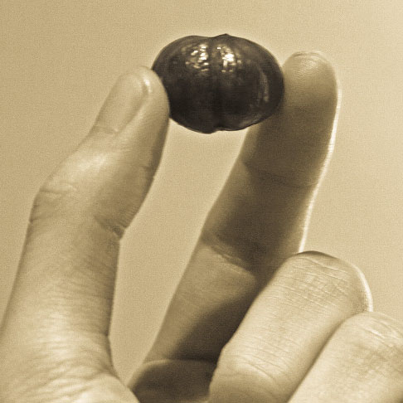
String Builder

Slide 27
Inheritance
  Pseudo Classical Inheritance
  Prototypal Inheritance
  Functional Inheritance

Slide 28
Classical Inheritance
Objects are instances of Classes.
A Class inherits from another Class.

Slide 29
Pseudo Classical Inheritance
In order to make one class inherit from another, you simply need to set the sub class’s prototype to point to an instance of the super class.

Slide 30
Prototype object
Super Class
prototype
Sub Class
prototype
Prototype object

Slide 31
Prototype object
Super Class
prototype
id | string
Sub Class
prototype
Prototype object

Slide 32
Prototype object
Super Class
prototype
id | string
Sub Class
prototype
Prototype object

Slide 33
Prototype object
Super Class
prototype
id | string
Sub Class
prototype
Prototype object
id | string

Slide 34
Prototype object
Super Class
prototype
id | string
Sub Class
prototype
id | string

Slide 35
extend
function extend(superClass, subClass)
{
var o = new superClass();
subClass.prototype = o;
}

Slide 36
Pseudo Classical Inheritance
Wrap the process in a function called extend
Invoke the super class’s constructor for code reuse

Slide 37
Prototypal Inheritance
Objects inherit from objects.
An object contains a secret link to another object.

Slide 38
object

Slide 39
object
F = function
prototype

Slide 40
object
F = function
prototype

Slide 41
object
F = function
prototype
f = new F();

Slide 42
object
new object

Slide 43
object
new object
F2 = function
prototype

Slide 44
object
new object
F2 = function
prototype

Slide 45
object
new object
F2 = function
f2 = new F();
prototype

Slide 46
object
new object
even new object

Slide 47
clone
function clone(o){
var F = function(){};
F.prototype = o;
return new F();
}

Slide 48
Functional Inheritance
A function calls another function, takes the result, augments it, and returns it as though it did all the work.
Private members
Protected members
Super Methods

Slide 49
Inheritance
Pseudo classical pattern is well understood, widely used.
Pseudo classical patterns is less effective than prototypal pattern or parasitic pattern.
Functional pattern is good at information hiding and can access to super methods.

